Slide 1

Restaurant Sales Analysis Report
Anabil sneha De
WBBTI-ANP-C8484
ID: AF0434575

Slide 2
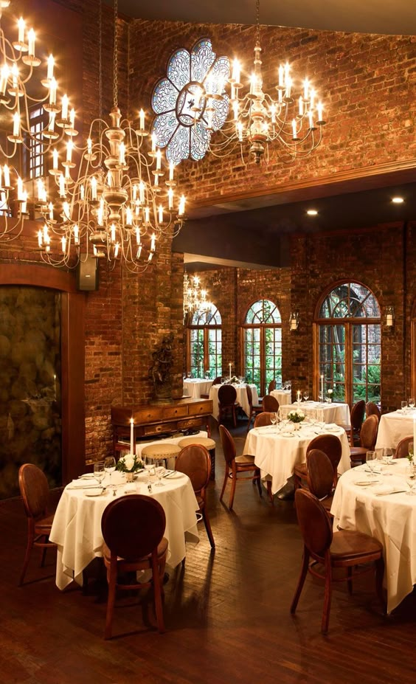
Problem statement
We have the sales data from a restaurant for the last 15 days, which includes details on customer visit times, types of orders, and the amount spent on each order. The restaurant offers a variety of menu items. However, the management is seeking ways to reduce costs and increase profits. Our task is to analyze this data, provide actionable insights, and visually represent the data to support our recommendations for cost-cutting and profit improvement.

Slide 3
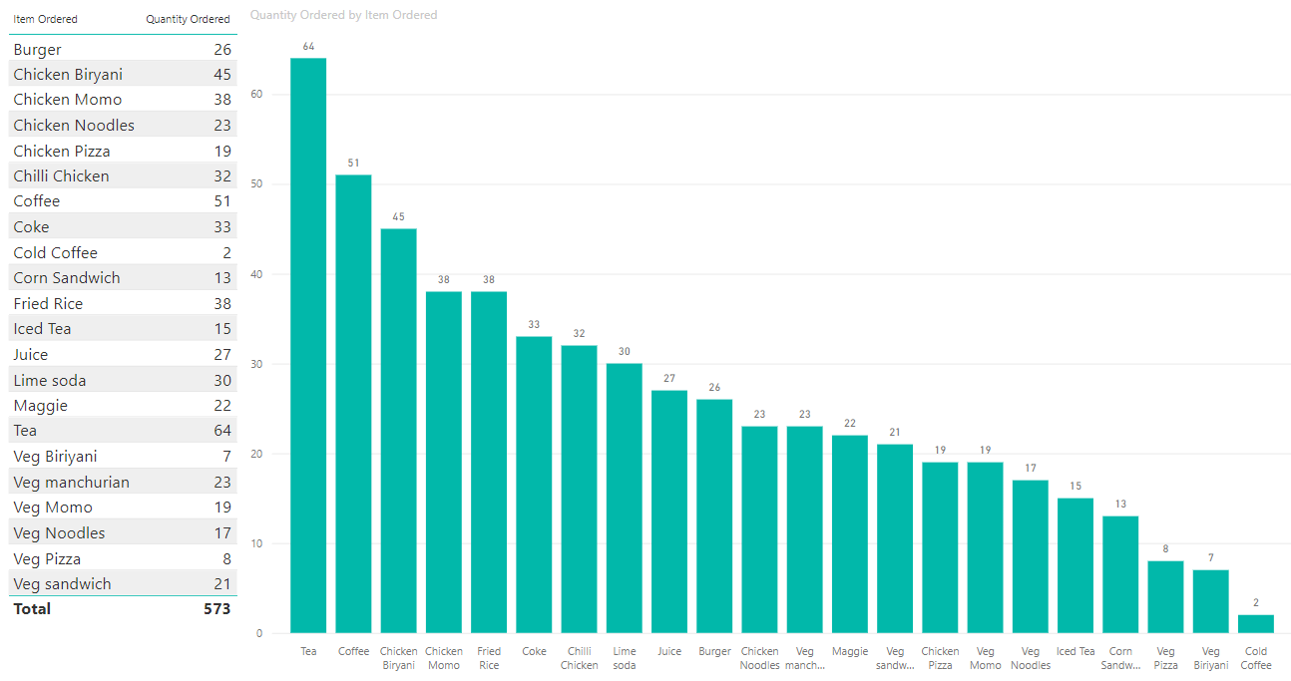
Item Ordered most and Item Ordered least
Here’s the conclusion based on the data:
Tea is the most sold item with 64 units.
Cold Coffee is the least sold item with only 2 units.
This suggests that Tea is the most popular item among customers, while Cold Coffee has the lowest demand. This insight could help with inventory decisions, marketing focus, or menu adjustments, depending on the business's objectives.

Slide 4
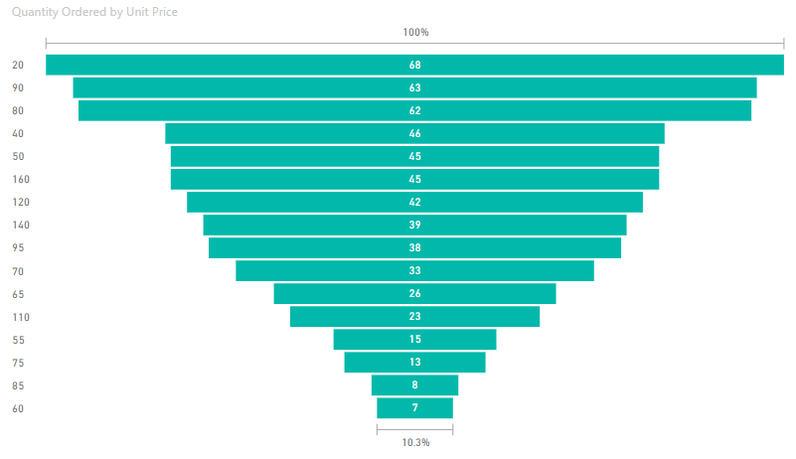
Units ordered in lowered or higher price items
Quantity ordered
It appears that lower-priced items have more units ordered compared to higher-priced items.
The top section of the funnel, which represents lower-priced items, shows higher quantities ordered (e.g., 68, 63, 62), while as the price increases (moving down the funnel), the quantity ordered decreases, with the lowest numbers at the bottom (e.g., 7, 8, 13).
This indicates a trend where customers tend to order more units of lower-priced items in a single order compared to higher-priced items.
Unit price

Slide 5
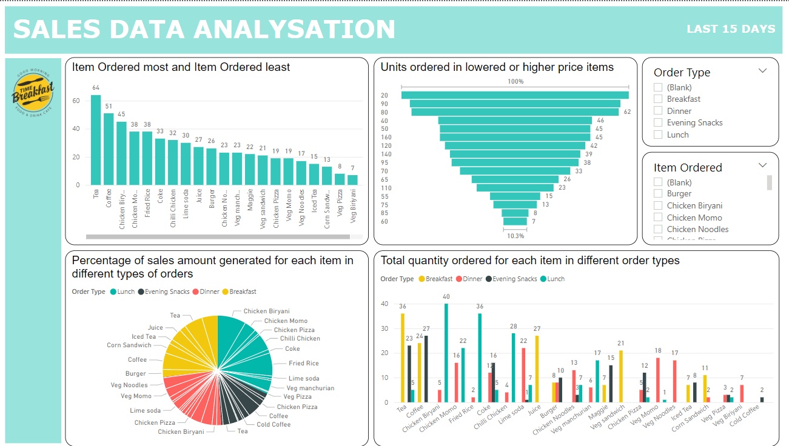

Slide 6
Questions and Conclusions
NOTE :
1. Items being ordered by customers in at least 3 meal types:
Tea: Ordered during breakfast, evening snacks, and dinner.
Coffee: Ordered during breakfast, evening snacks, and lunch.
Chicken Biryani: Ordered during lunch, dinner, and occasionally snacks.
Fried Rice: Ordered across lunch, dinner, and snacks.
Chicken Momo: Appears during lunch, dinner, and snacks.
1. What items are sold more and what items are sold less in what type of meal?
Items sold more and less in different types of meals:
Most sold items:
Tea (64 units) and Coffee (51 units) are the highest-selling items, especially during breakfast and evening snacks.
Chicken Biryani (45 units) and Fried Rice (38 units) perform well during lunch and dinner.
Least sold items:
Cold Coffee (2 units) and Veg Biryani (7 units) have the lowest sales across all meal times.

Slide 7
Questions and Conclusions
NOTE :
2. Items being ordered in more than one meal type:
Veg Manchurian: Ordered during lunch and snacks.
Chicken Pizza: Ordered during lunch and dinner.
Veg Sandwich: Ordered during breakfast and lunch.
Lime Soda: Ordered during snacks and lunch.
Chilli Chicken: Appears during lunch and dinner.
2. Sale of which items in what type of meal generate a greater amount of sales?
Items generating the most sales:
Tea, Coffee, and Chicken Biryani generate the most sales volume due to their high demand across breakfast and lunch/dinner.
Low-performance items like Cold Coffee and Veg Biryani generate minimal sales, contributing less to overall revenue.

Slide 8

Questions and Conclusions
3. Should the company continue offering all items at different times of the day?
High-performing items like Tea, Coffee, Fried Rice, and Chicken Biryani should continue to be offered at their respective peak times (e.g., Tea/Coffee during breakfast and evening snacks, Biryani/Fried Rice during lunch and dinner).
Low-performing items like Cold Coffee and Veg Biryani can be reconsidered for discontinuation or limited to specific time slots where they perform better.

Slide 9
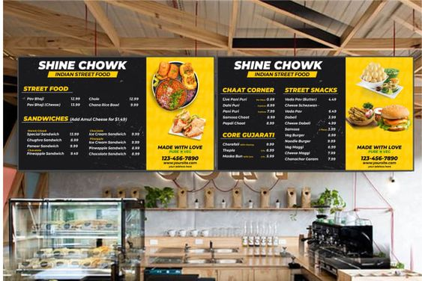
Questions and Conclusions
4. Actionable insights from the analysis for cost-cutting and improving the profit
Actionable insights for cost-cutting and improving profit:
Focus on high-demand items: Prioritize stocking and promoting items like Tea, Coffee, Chicken Biryani, and Fried Rice.
Discontinue or limit low-demand items: Consider removing or offering items like Cold Coffee and Veg Biryani only at specific times to reduce waste and operational costs.
Time-slot optimization: Tailor the menu to emphasize items that perform well during specific meals. For example, push sales for sandwiches during lunch and lighter beverages during evening snacks.

Slide 10
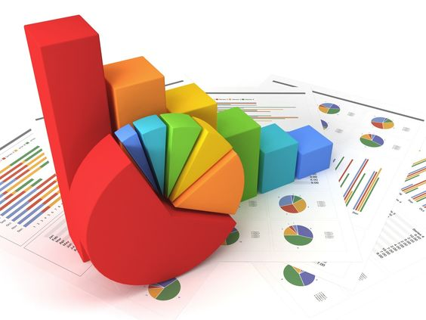
THANK YOU
Anabil sneha De
WBBTI-ANP-C8484
ID: AF0434575

